Slide 1

Part 2: Query Examples
Semantic Web3D: Towards Comprehensive Representation of 3D Content on the Semantic Web
Part 2: Query Examples
International Conference on 3D Immersion (IC3D)
in Brussels Belgium, 11-12 December 2019.
Jakub Flotyński, Don Brutzman, Felix G. Hamza-Lup,
Athanasios Malamos, Nicholas Polys, Leslie F. Sikos, and Krzysztof Walczak
semantics-public@web3d.org

Slide 2
Presentation Outline
X3D Semantic Web Working Group
Motivations for Semantic 3D content
The Semantic Web3D Approach
X3D Ontology and Knowledge Bases
Examples
Conclusions and Future Work

Slide 3
3D/VR/AR on the Web
Integration of 3D/VR/AR with Web browsers
Wide accessibility and collaborative environments
Content formats, e.g., Extensible 3D (X3D)
Programming libraries, e.g. WebGL
Interfaces, e.g. WebXR

Slide 4
The Semantic Web
Global database linking structured content with semantic descriptions
Ontologies and knowledge bases
Applicable to any domain
Enables
Content description at arbitrary specification level
Reasoning
Queries
W3C Standards: RDF, RDFS, OWL, SPARQL
No integration between 3D/VR/AR and the Semantic Web

Slide 5
X3D Semantic Web Working Group
Maximize interoperability with Semantic Web standards for greatest possible reuse and integration of 3D with the web
Efficient indexing, search, comparison, and analysis of X3D models through the advanced use of metadata and semantics
Create, partially autogenerate X3Dv4 OWL Ontology from the X3D Unified Object Model (X3DUOM) using best-practice design patterns
Support various Web3D Working Groups including Computer-Aided Design (CAD), 3D printing/scanning, Medical, Cultural and Natural Heritage, Humanoid Animation (HAnim)
Design work may consider other potential domains such as Building Information Models (BIM), etc.
Build and maintain a list of domain-specific ontologies that are suitable for use in concert with the X3D Ontology.

Slide 6
Motivations for Semantic 3D Content
Compliant with current Web evolution (Semantic Web)
Facilitates
Management (indexing, searching)
Exploration (reasoning, queries)
Modeling (non-IT-specialists)
of 3D content
Independent of particular 3D formats and presentation platforms
Different levels of specificity (3D and application/domain)
Declarative content representation

Slide 7
Examples of Semantic 3D
Complexity of 3D scenes in terms of object hierarchies, e.g. complex objects vs. meshes
Motion trajectories of 3D objects based on position and orientation interpolators, e.g., linear, curved, rotary
Categories of objects based on their properties, e.g., 3D engines based on the cylinder arrangement

Slide 8
Example Semantics of 3D Content
Semantic description of 3D scene enables answers to semantic reasoning and queries about it
Reasoning and queries may cover properties of 3D objects
At both 3D and domain levels of specificity
Related to different content features
Geometry, e.g.,
What is the type of a shape? (3D-specific)
What is the category of a car based on its shape? (domain-specific)
Structure, e.g.,
How many polygons does a 3D model have? (3D-specific)
What are components of a virtual car? (domain-specific)
Presentation, e.g.,
Which objects in a scene use a common texture? (3D-specific)
Which objects in a scene are made of wood? (domain-specific)
Behavior, e.g.,
What scripts describe the behavior of an object? (3D-specific)
What is the exercise performed by an avatar? (domain-specific)
Combining specificity levels by ontology mapping, e.g., virtual museum ontology to 3D ontology

Slide 9
The Semantic Web3D
Current efforts of the working group
Application of the semantic web to 3D technologies intended to support:
Development,
Management, and
Usage
… of 3D content on the web

Slide 10
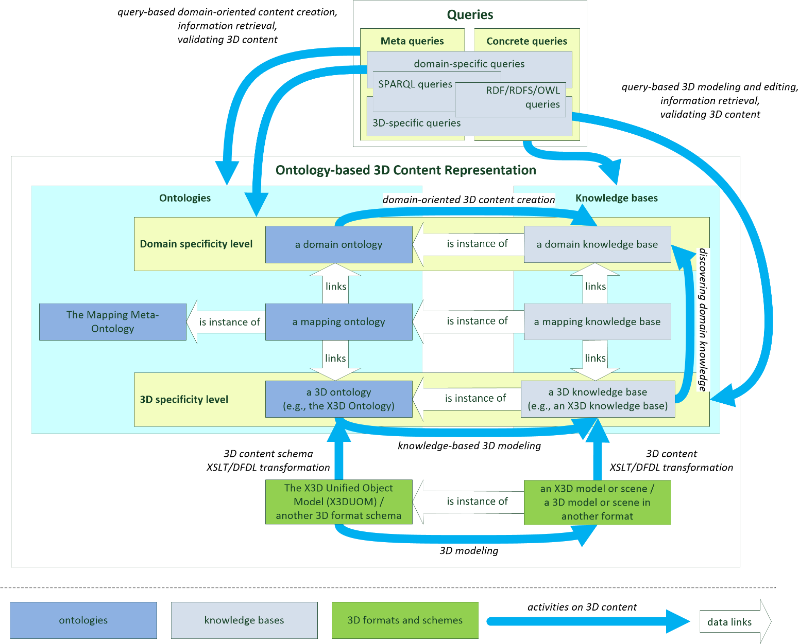
Semantic Web3D

Slide 11
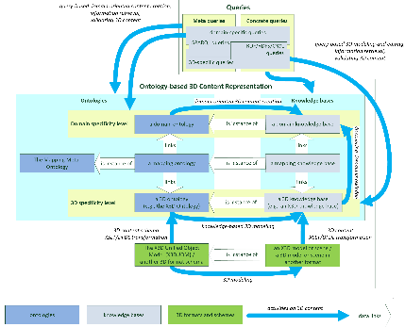
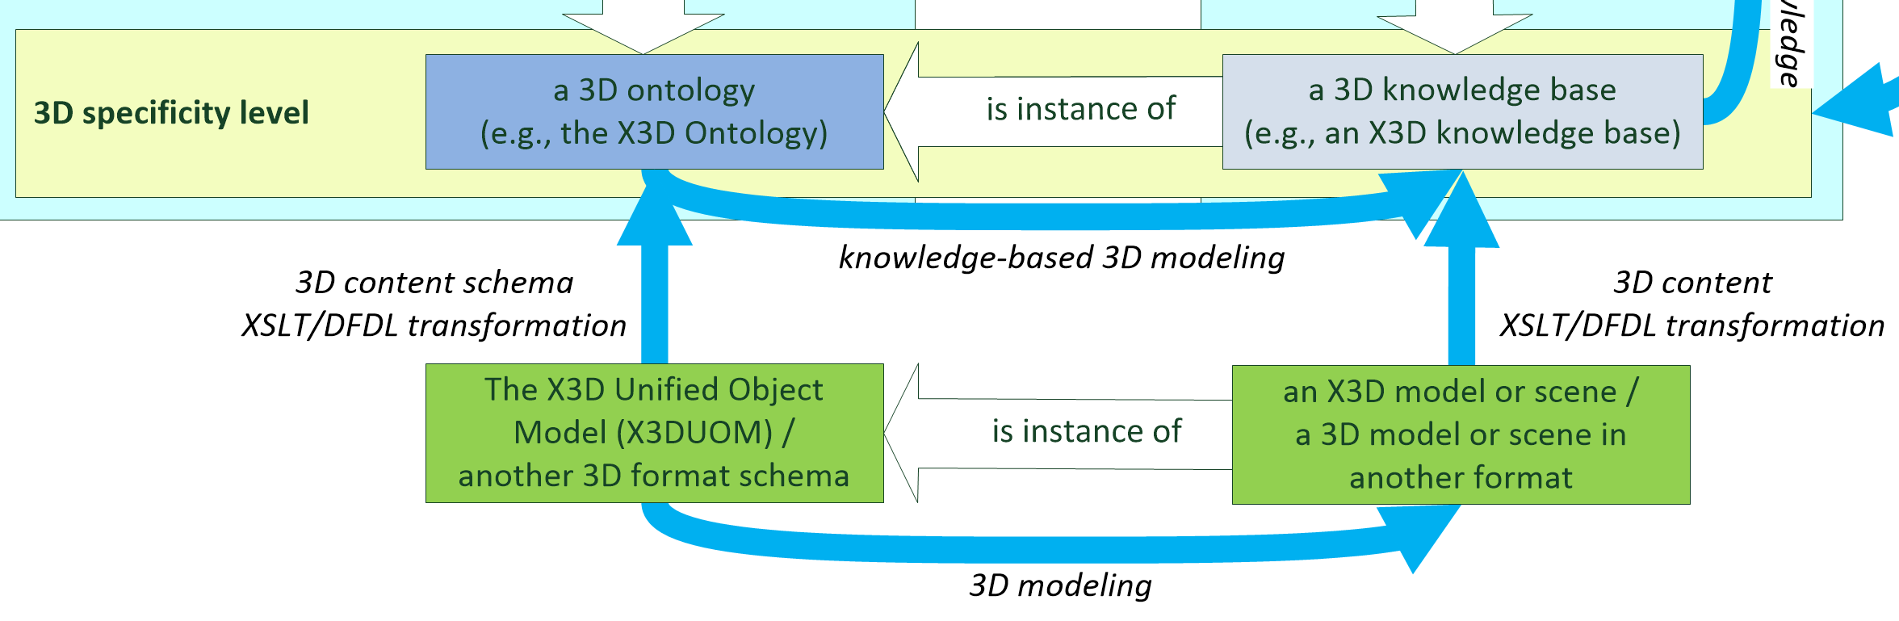
3D Content and Transformations

Slide 12
X3D Ontology
Semantic representation of the X3D format
Automatically generated from the X3D Unified Object Model (X3DUOM) via XSLT
Encoded in RDF, RDFS, OWL
Queryable with SPARQL
Enables reasoning

Slide 13
Advantages
Up-to-date representation of various 3D features
Geometry
Structure
Presentation
Animation
Automatic generation of semantic X3D repositories based on already-available 3D models
Reasoning and querying over transcribed versions of available X3D content

Slide 14
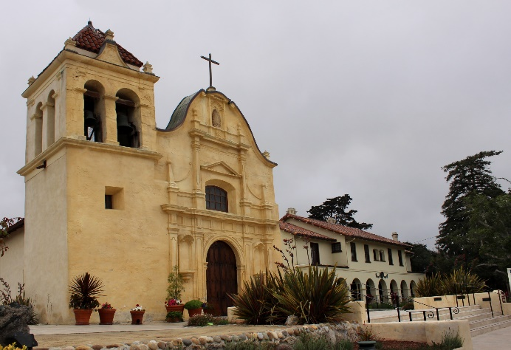
Example: San Carlos Cathedral
https://x3dgraphics.com/examples/X3dForAdvancedModeling/SanCarlosCathedral
https://upload.wikimedia.org/wikipedia/
commons/c/c1/Monterey%2C_California_-_
Cathedral_of_San_Carlos_Borromeo_%28
Royal_Presidio_Chapel%29_-_panoramio.jpg

Slide 15
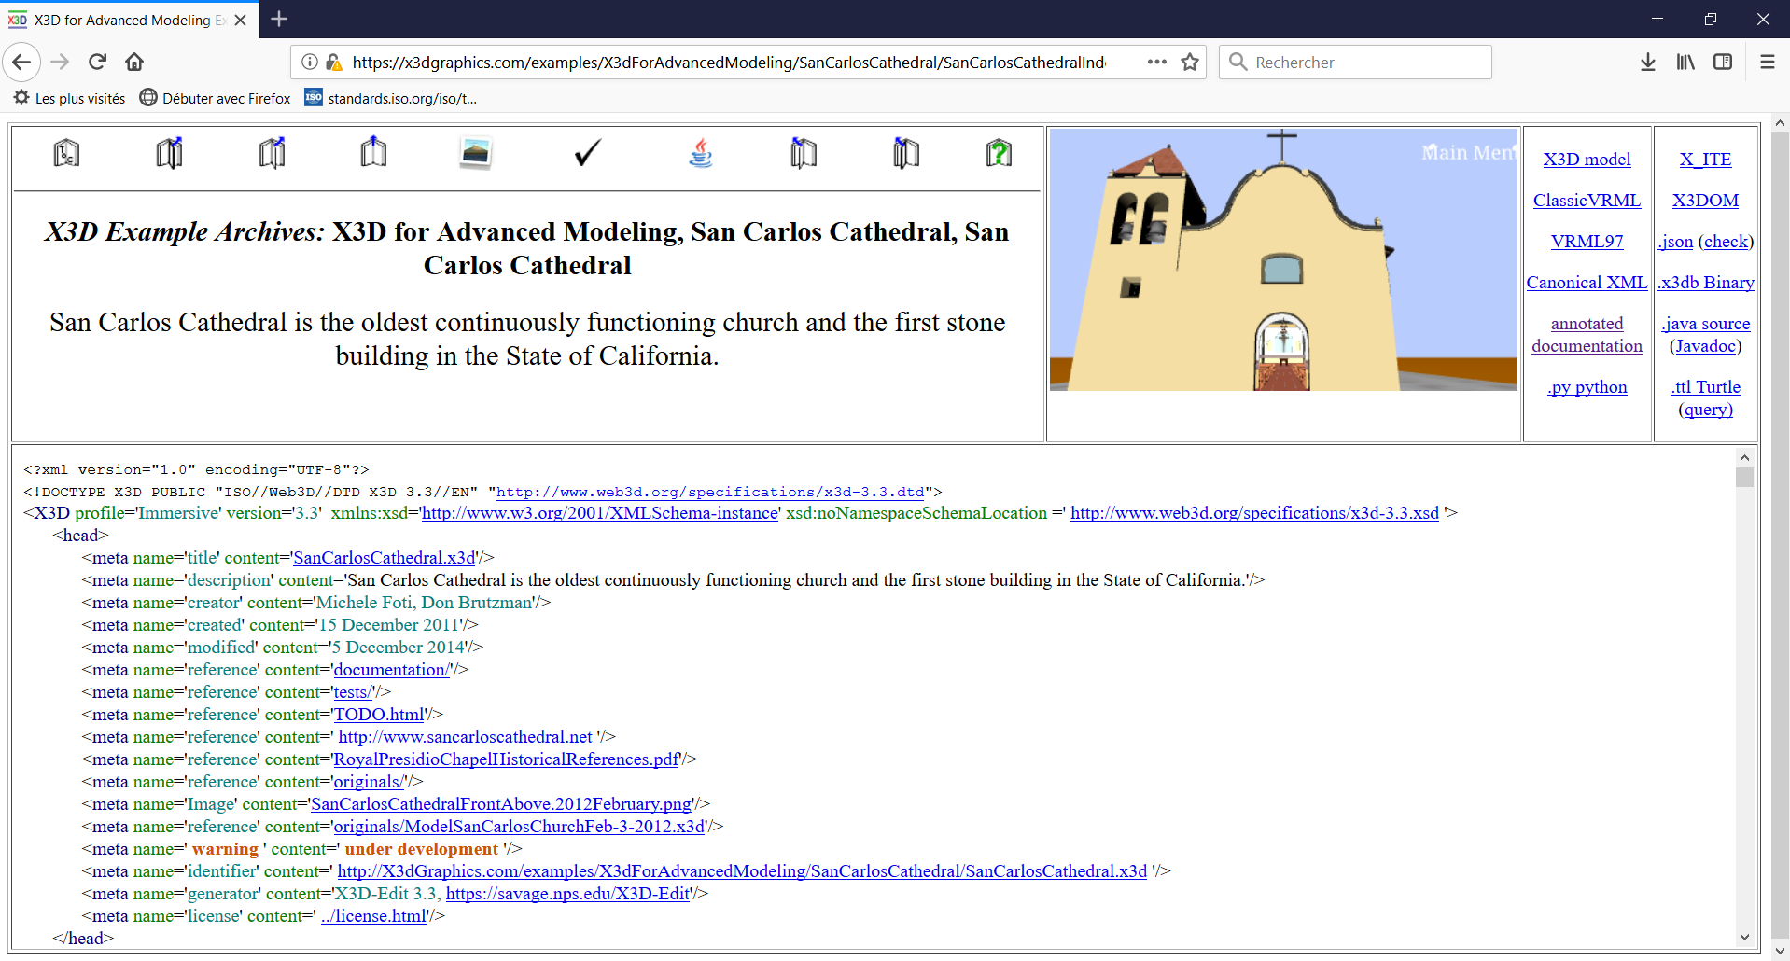
Example: San Carlos Cathedral
https://x3dgraphics.com/examples/X3dForAdvancedModeling/SanCarlosCathedral

Slide 16
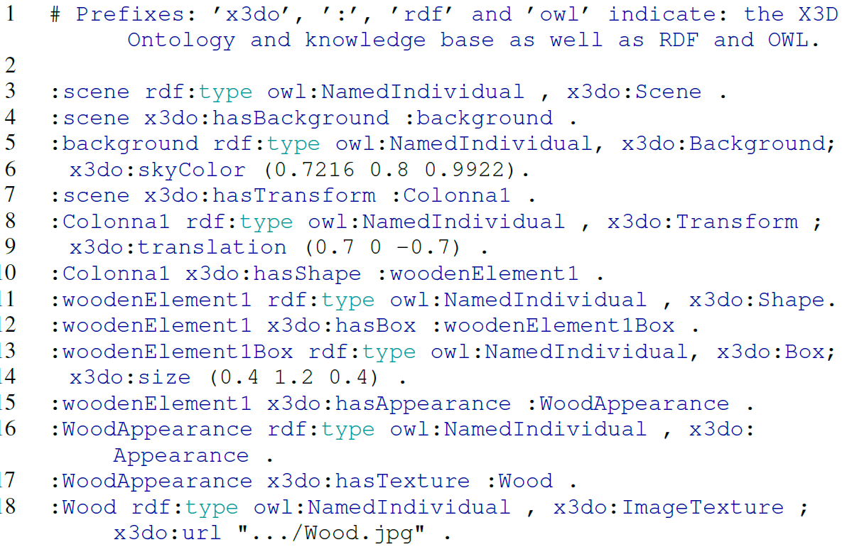
Cathedral: semantic representation
Turtle (.ttl)
WorldInfo Query

Slide 17

Cathedral: SPARQL semantic query 1
How many shapes together compose the altar?
Query and result

Slide 18
X3dSanCarlosCathedralAltarQuery_01.rq.txt
Perform X3D Ontology query X3dSanCarlosCathedralAltarQuery_01.rq using examples/Altar.ttl to produce output file X3dSanCarlosCathedralAltarQuery_01.rq.txt:
===========================
PREFIX rdf: <http://www.w3.org/1999/02/22-rdf-syntax-ns#>
PREFIX rdfs: <http://www.w3.org/2000/01/rdf-schema#>
PREFIX owl: <http://www.w3.org/2002/07/owl#>
PREFIX xsd: <http://www.w3.org/2001/XMLSchema#>
PREFIX x3d: <http://www.web3d.org/specifications/x3d-4.0.xsd#>
PREFIX x3do: <http://www.web3d.org/semantics/ontologies/X3dOntology4.0#>
# X3dSanCarlosCathedralAltarQuery_01.rq Query Altar.ttl to count numberShapes
###############################################
# Every X3D knowledge base can be subject to semantic queries.
# The following SPARQL query provides the number of shapes composing the altar.
# The result of the query is: 14.
SELECT (count(distinct ?shape) as ?numberShapes)
WHERE
{
?shape rdf:type x3do:Shape .
}
###############################################
----------------
| numberShapes |
================
| 14 |
----------------

Slide 19
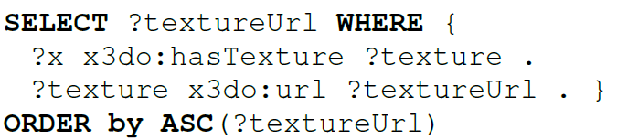
Cathedral: SPARQL semantic query 2
What textures are used for the 3D model?
Query and result

Slide 20
X3dSanCarlosCathedralAltarQuery_02.rq.txt
Perform X3D Ontology query X3dSanCarlosCathedralAltarQuery_02.rq using examples/Altar.ttl to produce output file X3dSanCarlosCathedralAltarQuery_02.rq.txt:
===========================
# (PREFIX headers omitted)
# X3dSanCarlosCathedralAltarQuery_02.rq Query Altar.ttl for texture url values.
###############################################
# Every X3D knowledge base can be subject to semantic queries.
# The following query provides the url addresses of all textures used within the scene.
# The result is the wood texture: ../Wood.jpg (cf. Listing 3, line 18)
SELECT ?appearanceNode ?textureUrl
WHERE
{
?appearance x3do:hasTexture ?texture .
?texture x3do:url ?textureUrl .
BIND (strafter(xsd:string(?appearance),"#") AS ?appearanceNode)
}
ORDER by ASC(?textureUrl)
###############################################
---------------------------------------------------------------------------------------------------------| appearanceNode | textureUrl |
=========================================================================================================| "WoodAppearance" | "\"images/Wood.jpg\"
\“https://x3dgraphics.com/examples/X3dForAdvancedModeling/SanCarlosCathedral/images/Wood.jpg\"" |
---------------------------------------------------------------------------------------------------------

Slide 21

Cathedral: SPARQL semantic query 3
What is the sky color?
Query and result

Slide 22
X3dSanCarlosCathedralAltarQuery_03.rq.txt
Perform X3D Ontology query X3dSanCarlosCathedralAltarQuery_03.rq using examples/Altar.ttl to produce output file X3dSanCarlosCathedralAltarQuery_03.rq.txt:
# (PREFIX headers omitted)
# X3dSanCarlosCathedralAltarQuery_03.rq Query Altar.ttl to determine Background skyColor values.
###############################################
# Every X3D knowledge base can be subject to semantic queries.
# The following query retrieves the Background skyColor used in the scene.
# The result is the following list of RGB values: (0.7216 0.8 0.9922) (cf. Listing 3, line 6).
# Note special handling of RDF lists:
# Bob DuCharme's weblog, 21 April 2014, "RDF lists and SPARQL"
# http://www.snee.com/bobdc.blog/2014/04/rdf-lists-and-sparql.html
SELECT ?backgroundNode ?skyColorListValues
WHERE
{
?background rdf:type x3do:Background ;
x3do:skyColor/rdf:rest*/rdf:first ?skyColorListValues .
BIND (strafter(xsd:string(?background),"#") AS ?backgroundNode)
# TODO re-aggregate skyColor list values into list of tuples
}
###############################################
-----------------------------------------
| backgroundNode | skyColorListValues |
=========================================
| "Background_2_2" | 0.7216 |
| "Background_2_2" | 0.8 |
| "Background_2_2" | 0.9922 |
-----------------------------------------

Slide 23
Conclusions and Future Work
Advantages of the presented approach
Integration of the Semantic Web and 3D
Up-to-date with all versions of X3D
Automatic generation of ontology eliminates potential errors
Queries and reasoning become feasible, consistent
Platform-independent
Future work
Integration with achievements of other Web3D Working Groups
Integration with metadata and semantics in X3D metadata nodes
Mapping to diverse domain ontologies

Slide 24
The Semantic Web3D: Towards Comprehensive Representation of 3D Content on the Semantic Web
Thank you for your attention
Jakub Flotyński, Don Brutzman, Felix G. Hamza-Lup,
Athanasios Malamos, Nicholas Polys, Leslie F. Sikos, Krzysztof Walczak
semantics-public@web3d.org

